Slide 1

Digital Portfolio
STUDENT NAME: K.praveen
REGISTER NO AND NMID: 222402514 and asunm161222402514
DEPARTMENT: BSc.,Computer science
COLLEGE: Prince Shri Venkateswara Arts And Science college/Madras University
1
1
Notes:
1

Slide 2

PROJECT TITLE
Digital Portfolio
2
2

Slide 3



AGENDA
Problem Statement
Project Overview
End Users
Tools and Technologies
Portfolio design and Layout
Features and Functionality
Results and Screenshots
Conclusion
Github Link
3
3/21/2024 Annual Review
3

Slide 4

PROBLEM STATEMENT
Create a modern, responsive, and accessible personal portfolio website for a front-end developer, I'm showcasing skills, and contact information to effectively engage potential clients and employers.
4
4

Slide 5

PROJECT OVERVIEW
This portfolio website for PRAVEEN is a dynamic, responsive platform designed to highlight his proficiency as a front-end developer. It features sections about his skills, professional background, personal projects, and contact details, all aimed at creating engaging digital experiences for visitors.
5
5

Slide 6

WHO ARE THE END USERS?
Potential employers and recruiters seeking front-end development talent.
Collaborators looking to partner on technical or creative projects.
Peers and industry professionals exploring his work networking.
6
6

Slide 7

TOOLS AND TECHNIQUES
Git & GitHub: history tracking.
Visual Studio Code: code editor.
HTML & CSS: Fundamental for building and styling web pages.
7
7

Slide 8
POTFOLIO DESIGN AND LAYOUT
DESIGN
Strong color contrasts for readability.
padding and max-width for content focus.
Visual emphasis on key areas like the hero and contact sections.
LAYOUT
Home
About me
skills
Contact me
8
8

Slide 9
FEATURES AND FUNCTIONALITY
Features
Sticky Header Navigation
Hero Section with Call-to-Action
Skills Display
Contact Form
Contact Email Display
Functionality
Navigation links scroll down to corresponding page sections, enhancing user experience.
Button links trigger smooth section jumps using anchor-based navigation.
The design encourages user interaction with clear call-to-action areas
9

Slide 10
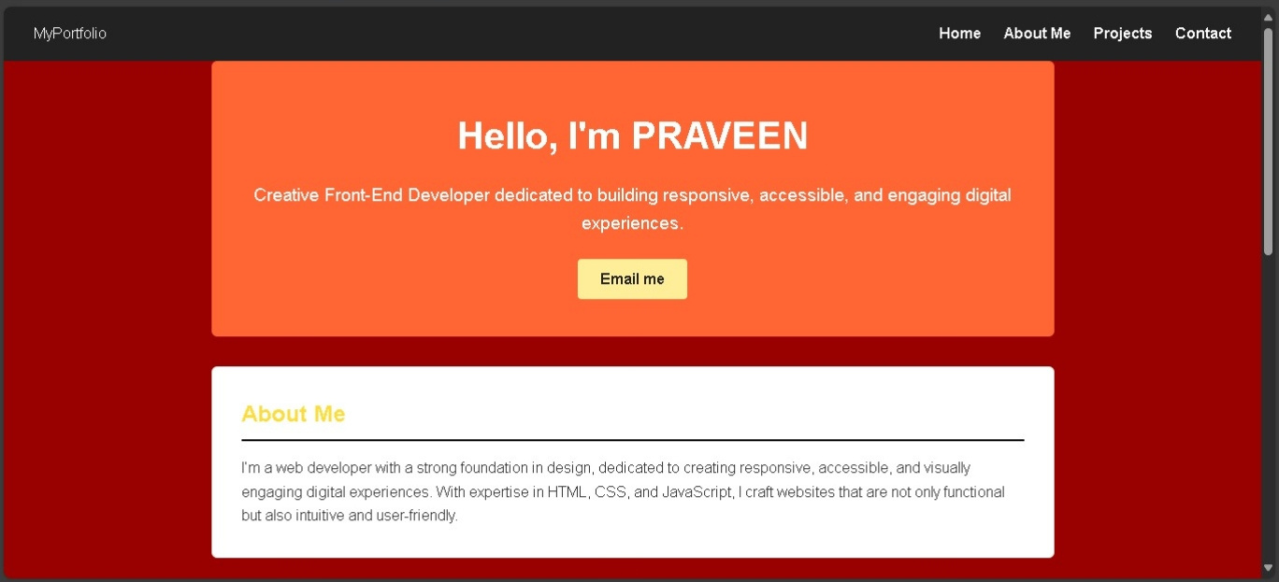

RESULTS AND SCREENSHOTS
10
3/21/2024 Annual Review
10

Slide 11
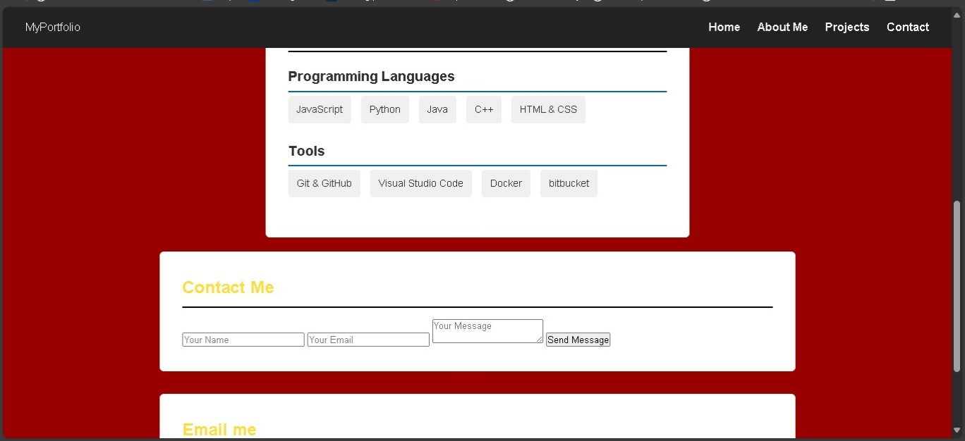
11
3/21/2024 Annual Review
10

Slide 12
CONCLUSION
This portfolio template combines modern HTML and CSS practices to deliver a clean, interactive, and professional presence, suitable for showcasing the developer's expertise and engaging potential clients or employers
12
11

Slide 13
GITHUB LINK
https://praveenk155.github.io/TNSDC-FWD-DP/
13
11

